Slide 1
Proposed System
Proposed System first builds a student model.
Inputs to the system comes from RLR & VLR like Cretal.
Once sufficient data is generated over the course of time, the system displays the generated data in a graphical way in both student and teacher perspective.

Slide 2
Proposed System
Later the system tries to identify a pattern in the data by using semi-supervised learning approaches and makes suggestions to both students and teachers.
The suggestions will improve over a period of time. More the data, better the prediction.
Since there are many ML algorithms, we need to decide on specific algorithm for a specific student/teacher model.

Slide 3


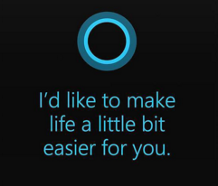
Discussion Forum
CRETAL
Input Model
RLR
SPAS

Slide 4
More Detailed Design
A very abstract level input .csv file currently under review

